Slide 1
Fundamentals of Remote Sensing
T3 - Burned area mapping

Slide 2
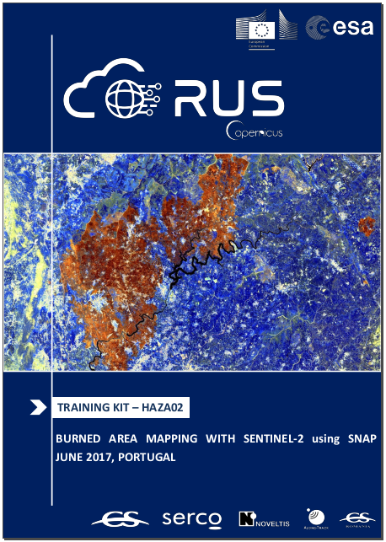
Burned area mapping
RUS Tutorial :
”HAZA02. BURNED AREA MAPPING WITH
SENTINEL-2 using SNAP….”
Data file (Sentinel-2) 2018 (post fire) : S2B_MSIL1C_20180629T034539_N0206_R104_T50WNS_20180629T064611
https://yadi.sk/d/SyH16prkWhjlcA
(subset: https://yadi.sk/d/ueQxm0Dj7qjEdw )
2017 ( before fires):
S2A_MSIL1C_20170805T033541_N0205_R061_T50WNS_20170805T033645
https://yadi.sk/d/baAP16b_gn_XhQ
(subset: https://yadi.sk/d/B9JP314Rqt0XVg )
Processing chain:
Resample to one resolution and subset source images
( done in the subset files)
Calculate Normalized Burn Ratio (NBR) ( see p11 of the Training kit)
Calculate NDVI (bands-?) and NDWI ( see p14)
Build Burned area mask, try to get rid of false detected features
Collocate 2018 (as a reference) and 2017 (pre-fire) images (p13)
Calculate RBR ( p15)
Try to visualize the results (either NBR, dRBR or RBR) using standard classification and palette on p18 ( in SNAP, no QGIS today)
M1
M2

